Slide 1

The Mushrooms - ELCA Challenge
Polyhack 2020
7./8. November 2020

Slide 2
The Challenge
Traffic simulation for Aarhus, Denmark
Use Python to interact with SUMO
Mission: Generate bus routes for randomly appearing pedestrians (bus passengers)
Targets (non-exhaustive):
Minimum number of buses
Minimum number of kilometers driven by all busses
Minimum total number of pedestrians not transported
Minimum total wait time of pedestrians

Slide 3
Thoughts on Solving the Challenge
In advance vs. real-time (re-)routing of buses
Proximity-based vs. “time of appearance” ordering for the pick-up of pedestrians
Penalty function for deciding whether to pick up or drop of a pedestrian, based on load factor of bus

Slide 4
Faced Challenges
Challenge is a variant of the Travelling Salesman Problem – this is NP-hard and can not be brute-forced: How to optimize?
Finding best (or “penalty”) function for knowing what to next at each simulation step
In real-time re-routing approach, issues encountered were:
Error when bus on junction at time of re-routing
Bug in setRoute function (driven route gets appended), therefor gradual slowdown during simulation => decision to pursue approach where all routes are competed at the start of the simulation

Slide 5
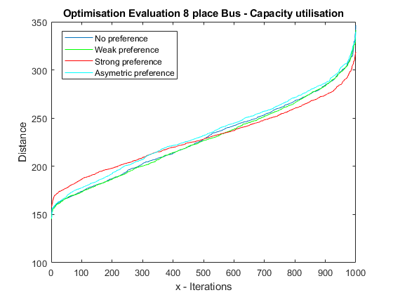
Penalty Function
Matlab simulation for weighing/penalty function for deciding whether to pick up or drop of pedestrians
Preference for leaning to pick up/off-load pedestrians
Distance: Lower is better (left side is preferable over right side)
Not implemented

Slide 6
Our Solution
Pedestrians are allocated to buses at the start of simulation, based on the time they spawn on the map
Buses are scheduled and routed to transport 4 pedestrians, then return to the depot
Transporting more than 4 pedestrians per bus leads to significantly more run-time, as the complexity increases with factorial
Of all possible routes to off-load four passengers, the best one is chosen

